Slide 1
GIT
Yash Jain

Slide 2
VCS (Version Control System)
Automatic backup
Sharing on multiple computers
Logging where be changed
Record history
Branch/merge development paths
Expose source code
Facilitate team work

Slide 3
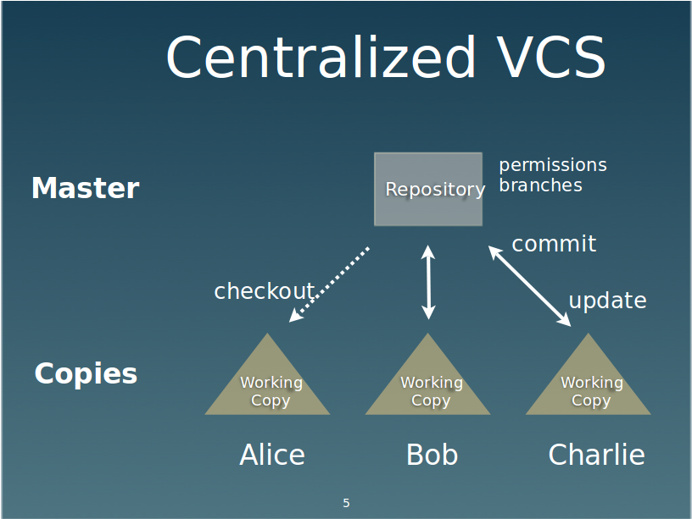

Slide 4
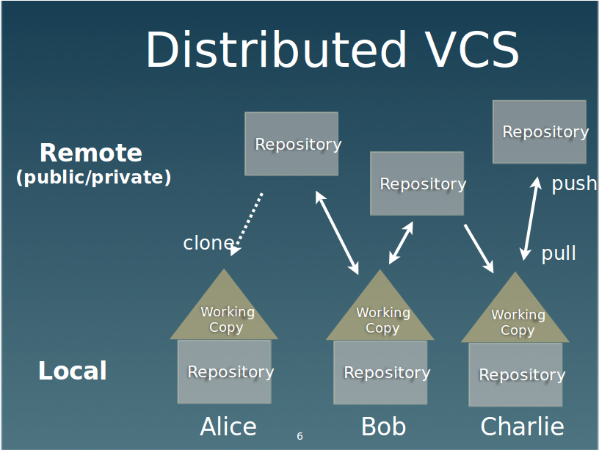

Slide 5
Centralized vs Distributed
Synchronous
unique reference
fixed hierarchy
centralized access control
Simpler
Asynchronous
copy = repository
loose hierarchy
Offline
History
Commit
Branches
More powerful

Slide 6
GIT History
Linus Torvalds
First prototype on April 7, 2005
Originally using VCS developed by BitKeeper
Global Information Tracker

Slide 7
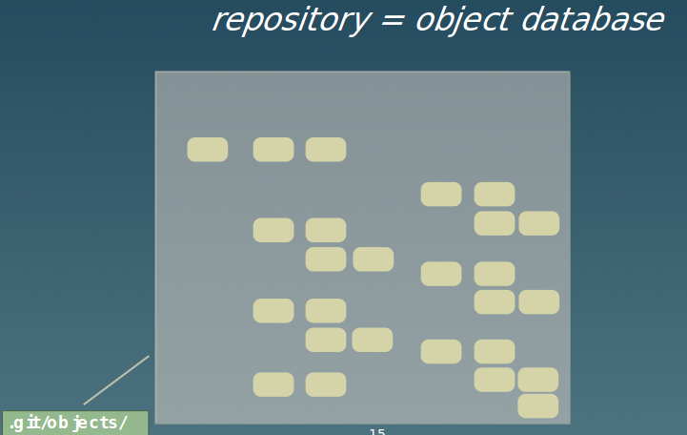
GIT Repository

Slide 8
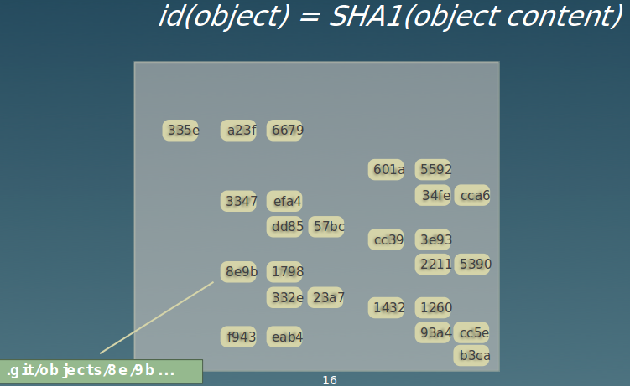

Slide 9
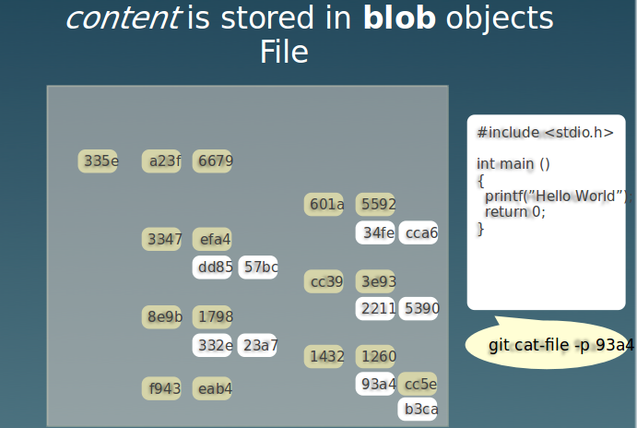

Slide 10
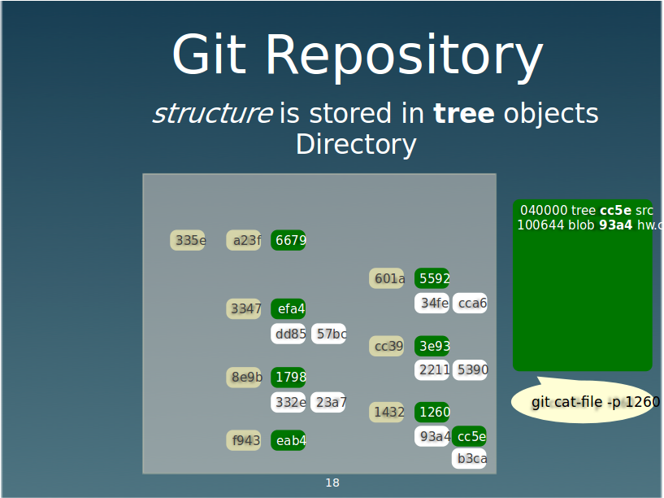

Slide 11
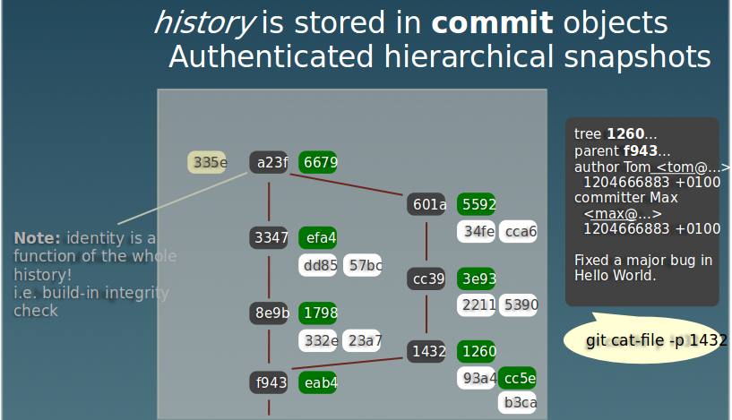

Slide 12
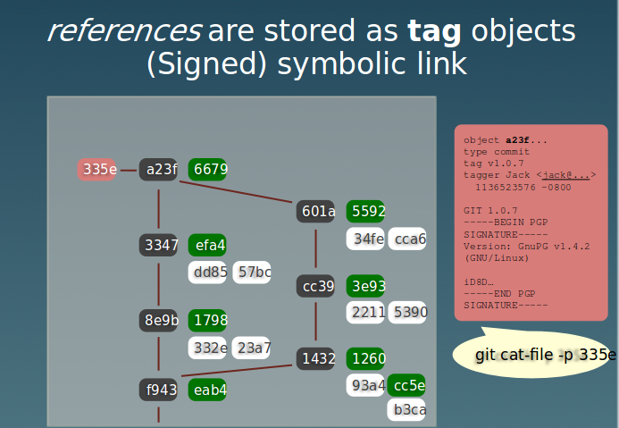

Slide 13
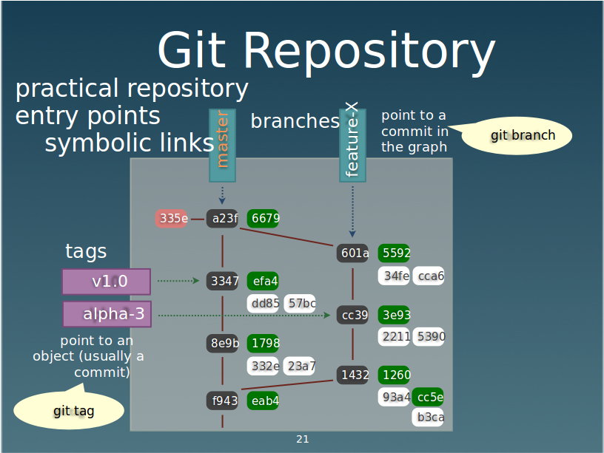

Slide 14
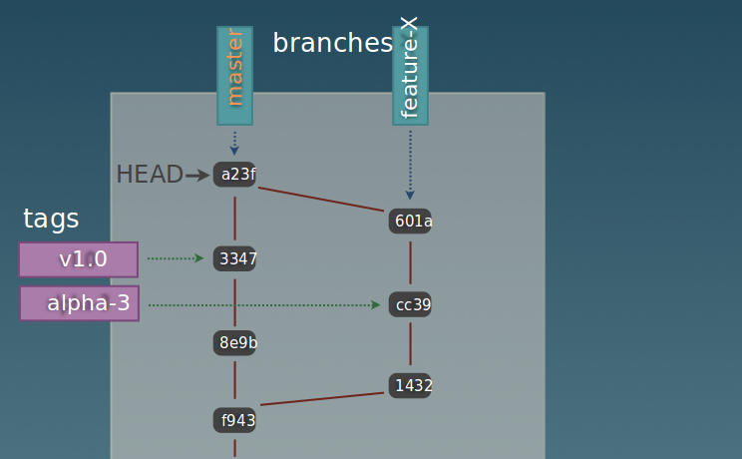
History Graph

Slide 15
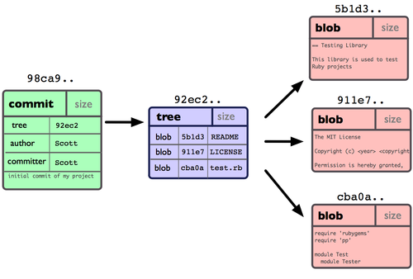
What a branch is

Slide 16
